Slide 1
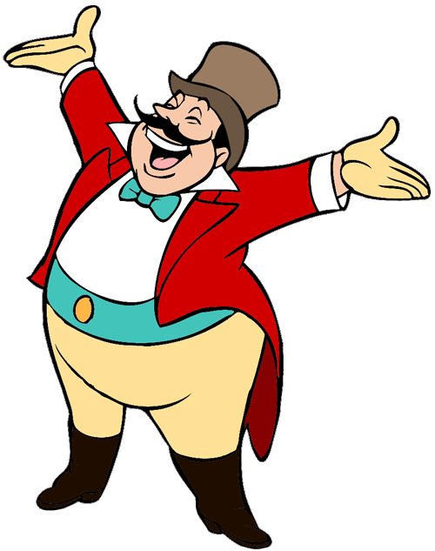
Present Continuous Tense
Throw The Ball
is
jump
play
He
swim
START
www.guorkhan.blogspot.com

Slide 2
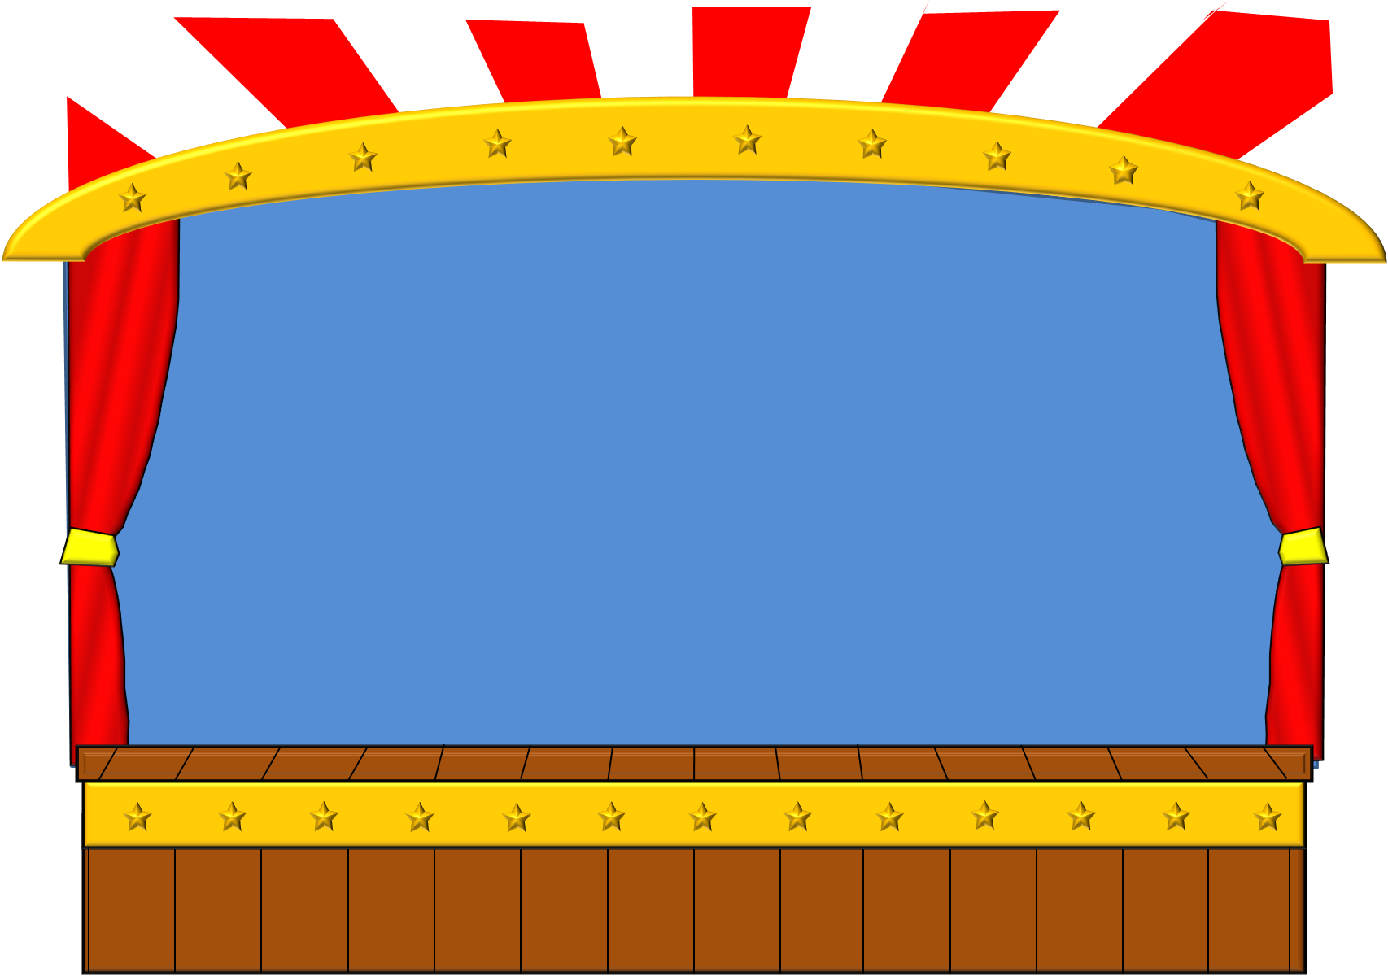
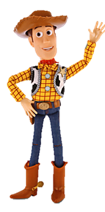
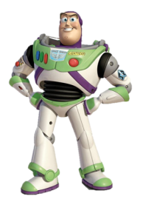
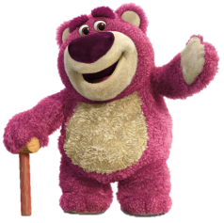
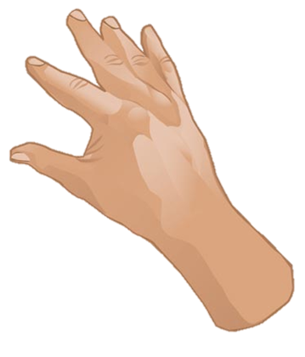
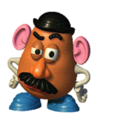
Then click on the right word.
Click to see the picture.
What is the girl doing?
Choose your prize
dance
swim
jump
play
He
is
She
is
dance .
She
-ing
study
cook
eat
read
www.guorkhan.blogspot.com
Try Again
Next

Slide 3
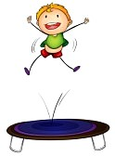
Click to see the picture.
What is the boy doing?
Choose your prize
She
jump
cry
dance
is
can
He
is
jump .
open
It
-ing
He
eat
have
www.guorkhan.blogspot.com
Try Again
Next

Slide 4
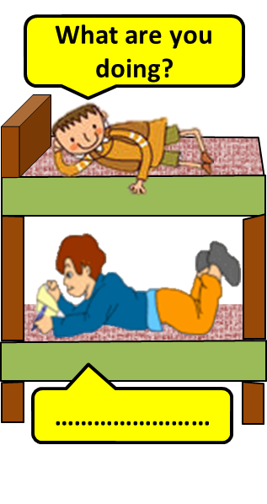
Click to see the picture.
Complete the dialogue.
Choose your prize
cry
I
point
He
study
stop
I
am
study .
am
answer
is
She
-ing
swim
www.guorkhan.blogspot.com
Try Again
Next

Slide 5
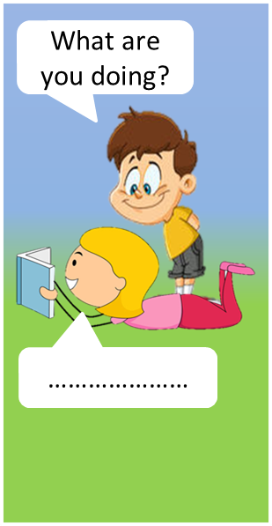
Click to see the picture.
Complete the dialogue.
Choose your prize
listen
I
She
-ing
read
ride
I
am
read .
jump
am
is
He
ask
answer
www.guorkhan.blogspot.com
Try Again
Next

Slide 6
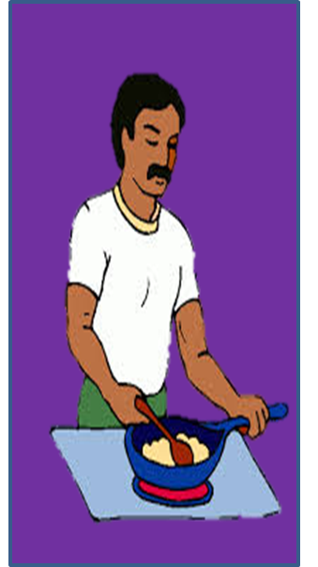
Click to see the picture.
What is the man doing?
Choose your prize
study
She
cook
-ing
is
It
He
is
cook .
dance
sing
play
jump
He
read
www.guorkhan.blogspot.com
Try Again
Next

Slide 7
Click to see the picture.
What is the girl doing?
Choose your prize
read
jump
cook
tennis
sleep
cry
She
is
cry .
study
-ing
is
She
He
read
www.guorkhan.blogspot.com
Try Again
Next

Slide 8
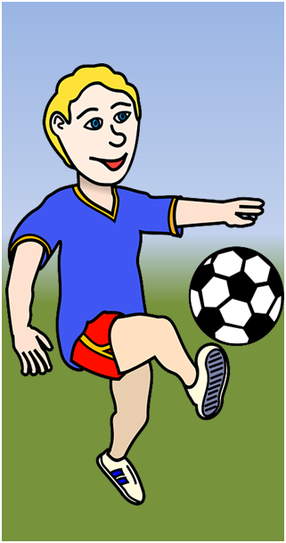
Click to see the picture.
What’s he doing?
Choose your prize
play
swim
tennis
foot-ball
She
is
He
is
play
football.
He
-ing
study
cook
eat
read
www.guorkhan.blogspot.com
Next
Try Again

Slide 9
Click to see the picture.
What is the dog doing?
Choose your prize
-ing
ask
It
guitar
sleep
stop
It
is
swimm .
am
answer
is
She
He
swim
www.guorkhan.blogspot.com
Try Again
Next

Slide 10
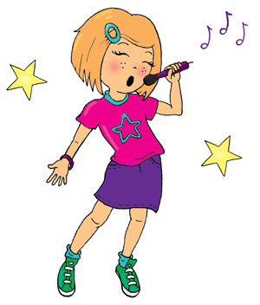
Click to see the picture.
What is she doing?
Choose your prize
He
sing
cry
dance
is
can
She
is
sing .
She
It
-ing
cook
eat
have
www.guorkhan.blogspot.com
Try Again
Next

Slide 11
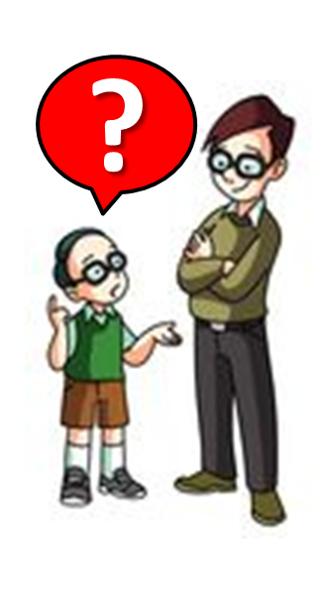
Click to see the picture.
What is the boy doing?
Choose your prize
study
She
ask
-ing
is
It
He
is
ask .
dance
sing
play
jump
He
read
www.guorkhan.blogspot.com
Try Again
Next

Slide 12
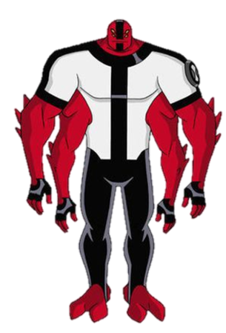
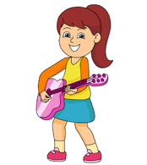
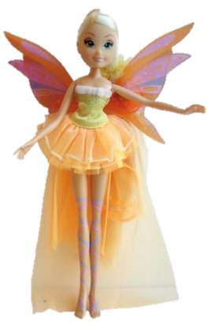
Click to see the picture.
What’s she doing?
Choose your prize
play
run
tennis
the guitar
He
is
She
is
play
the guitar.
I
-ing
study
cook
eat
She
www.guorkhan.blogspot.com
Try Again

Slide 13
www.guorkhan.blogspot.com

